Slide 1
HTML Starters

Slide 2
Think of at least 3 things in pairs you like to do on web pages
Notes:
Ask students to discuss on entrance, run through at start

Slide 3
In pairs, think of at least 4 HTML tags
a tag is an HTML command between< >
Notes:
Give 2 minutes, look for tags from last lesson

Slide 4
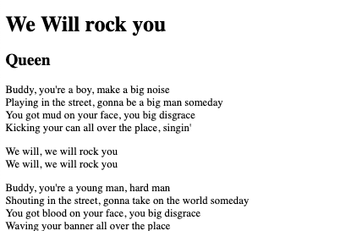
Which tags have been used to format this

Slide 5
In pairs, write the code to display a pictures called ‘funnyTeacher.jpg’

Slide 6
On paper, write a hyperlink to http://www.bbc.co.uk

Slide 7
In pairs, decide what this style will do to a paragraph
p{ font:20px Courier; color:purple; width:400px; margin-top:1cm;
margin:auto; }

Slide 8
What will these do to a picture ?
width:30%; margin-left: 5px; padding-right:5px; border: 2px solid green; float:left; display:block;

Slide 9
In pairs, what is the difference between an ID and a class, think of at least 3

